Slide 1
School Subjects and Classroom Objects - French
2nd grade
Here is where your presentation begins

Slide 2
Contents of this template
You can delete this slide when you’re done editing the presentation
Fonts | To view this template correctly in PowerPoint, download and install the fonts we used
Used and alternative resources | An assortment of graphic resources that are suitable for use in this presentation
Thanks slide | You must keep it so that proper credits for our design are given
Colors | All the colors used in this presentation
Icons and infographic resources | These can be used in the template, and their size and color can be edited
Editable presentation theme | You can edit the master slides easily. For more info, click here
For more info:
Slidesgo | Blog | FAQs
You can visit our sister projects:
Freepik | Flaticon | Storyset | Wepik | Videvo

Slide 3
What will we learn of this topic?
01
02
03
04
Vocabulary
Everyday expressions
Let's unlock exciting words and build amazing worlds together!
Discover cool phrases and expressions for daily adventures!
Stories and songs
Playful activities
Jump into exciting tales and catchy songs to learn this language!
Engage in games and creative projects that bring this language to life

Slide 4
Introduction
Step into the enchanting world of language discovery! Our journey begins with the exciting exploration of sounds, words, and expressions that make language so fascinating. Together, we'll learn how to greet new friends, introduce ourselves, and create a foundation for
clear communication
Through lively activities, every lesson becomes a delightful experience. From cheerful greetings to expressing simple emotions, each step takes us deeper into the wonders of language. Join us on this joy-filled adventure where laughter, friendship, and the thrill of discovering a new way of expressing ourselves await!

Slide 5
01
Vocabulary
Learning vocabulary is very important!

Slide 6
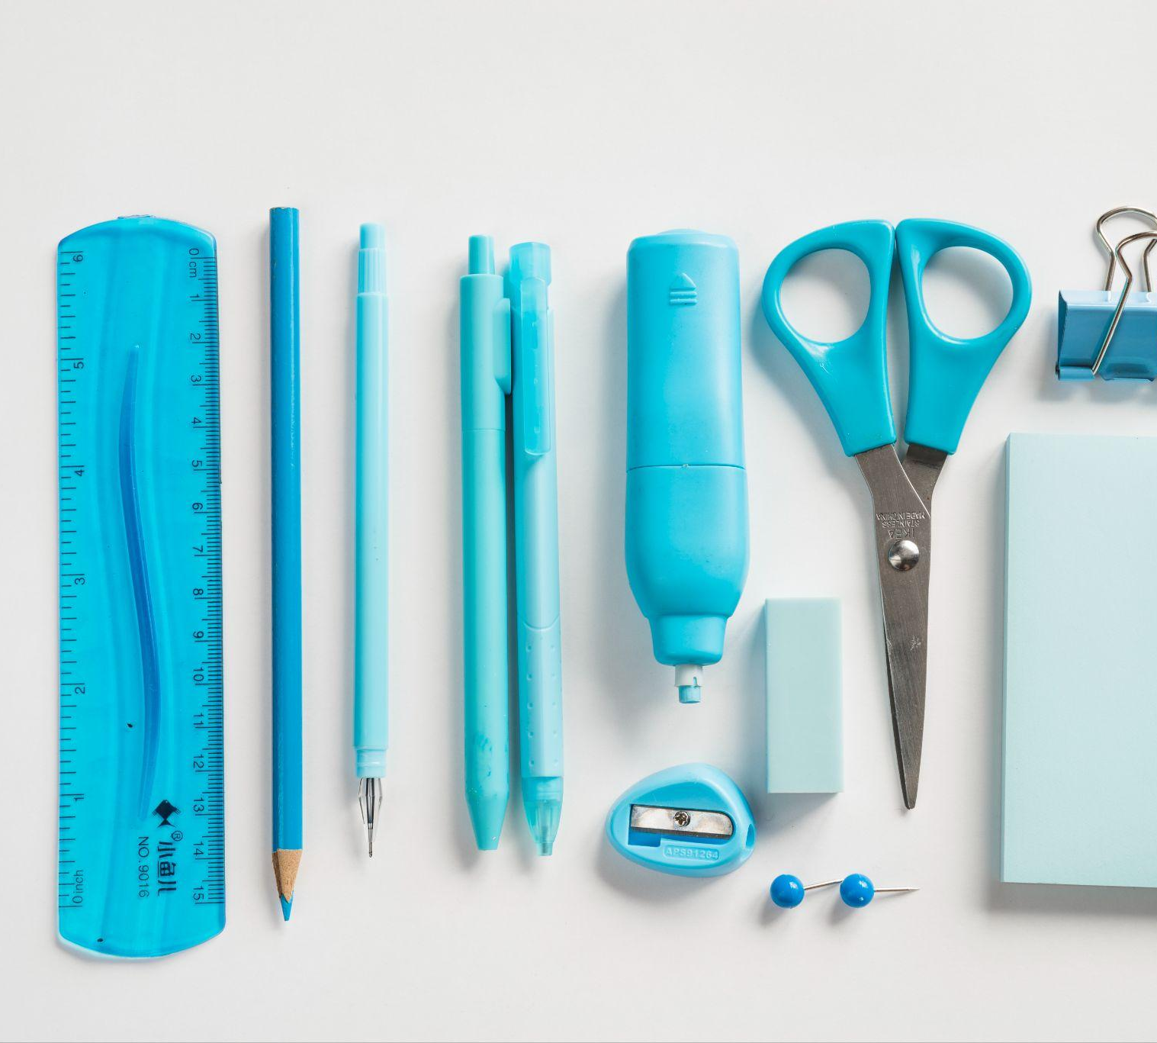
Welcome to the world of vocabulary!
In this section, we'll dive into the magical realm of words, discovering their meanings and how they help us express ideas. We are going to learn:
Word exploration
Language connections
Get ready for a vocabulary adventure where words come to life, and every discovery opens a new door to the wonders of language!

Slide 7



Activity 1: Describe the picture
Display a picture of something related to the topic. Have students discuss what they are seeing and fill in the missing part in the language they are learning
Can you describe this?
Can you describe this?
Can you describe this?
Write your answer
Write your answer
Write your answer

Slide 8
Everyday expressions
Fun phrases
Adventure talk
Chat confidence
Get ready for exciting expressions! From saying "Hi" to simple requests, we'll turn words into fun tools for talking
Learn phrases for daily fun! Role-playing and cool activities make these expressions your language superpowers!
Practice phrases for real chats. Dive into language fun, turning learning into a journey of self-expression!

Slide 9




Experiment: Classroom survey
Create a list of survey questions. Students have to circulate around the classroom, asking their classmates the questions and recording their responses in the target language
What’s your favorite…?
How often do you…?
Do you like…?
What is one thing you always…?

Slide 10
Stories and songs
Magical storytime
Rhythmic sing-along!
Let's dive into the magic of stories! We'll explore exciting tales full of adventures and giggles. With colorful pictures and fun characters, these stories will make learning language feel like a magical journey. After each story, we'll chat and maybe even act out parts of the tale together!
Get ready to sing and dance! In our musical time, we'll enjoy catchy tunes that make learning language super fun. We'll sing together, clap our hands, and maybe even create our own language songs. This is a time to celebrate sounds, words, and the joy of learning together!

Slide 11

"Words are magic—let's play with them!"

Slide 12
Fun ways to learn a language
Exciting and fun learning
Storytelling magic
Super fun rhyming
Each session turns learning into an adventure, making words exciting discoveries
Immerse in stories that weave language into tales, creating experiences
Catchy tunes and playful words make language learning enjoyable
Interactive conversations
Creative
projects
Language in motion
Through discussions, students practice expressing themselves
Hands-on projects allow students to express themselves in diverse ways
Move and learn! Incorporating movement enhances memory

Slide 13
Activity 2: Matching opposites
Display a list of opposite word pairs in the target language. Have the students in the class match them correctly
Word 1
Opposite 3
Word 2
Opposite 1
Word 3
Opposite 4
Word 4
Opposite 2

Slide 14
We love this language!

Slide 15
123,000
Tell your students how many people in the world speak the language and get their curiosity piqued!

Slide 16


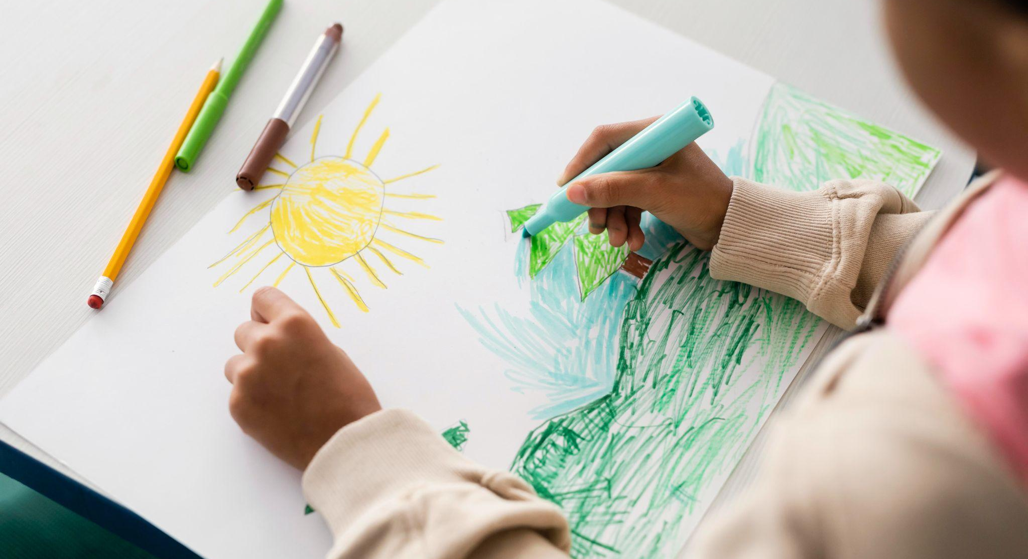
Activity 3: Story building
Share three images with the same theme. Start a story with the first image in the target language. Students have to add to the story with sentences
This is the start of the story
What happened next?
A problem develops
What happened first?
An unexpected event
How is it resolved?
This is the consequence
We meet someone new
The end to the adventure!

Slide 17
Language study timeline
Sound play
Word masters
Dancing with words and creating rhymes!
Becoming language of the true champions!
2XXX
2XXX
2XXX
2XXX
Word beginnings
Storytime
Exploring the ABCs and first words!
Reading tales and making language pals!

Slide 18
What have we learned?
Vocabulary
Everyday expressions
Stories
Songs
Culture

Slide 19
Game time: Treasure hunt
Choose a topic in your target language, create a treasure and prepare a series of clues. Students will have to understand the language in order to solve the clues and move to different locations
Write your first clue
Delete to show clue 1
Teams | Clue 1 | Clue 2 | Clue 3
Team 1
Team 2
Write your second clue
Delete to show clue 2
Write your third clue
Delete to show clue 3

Slide 20
Thanks!
Do you have any questions?
youremail@freepik.com
+34 654 321 432
yourwebsite.com
Please keep this slide for attribution

